Slide 1
ANSYS客户化开发工具及其典型应用
王昱皓
yh.wang@peraglobal.com
15011276650

Slide 2
目录
客户化定制开发技术及方向
面向工程的客户化定制开发应用

Slide 3
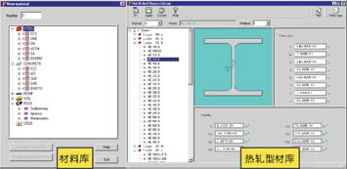
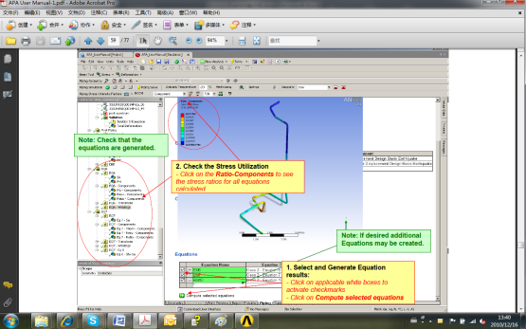
ANSYS客户化定制开发
基于ANSYS的CivilFEM系统
基于WorkBench的APA系统
特定流程
行业规范
应用习惯
特殊边界
自研算法
……
CivilFEM

Slide 4

ANSYS客户化定制开发

Slide 5
客户化定制开发技术及方向

Slide 6
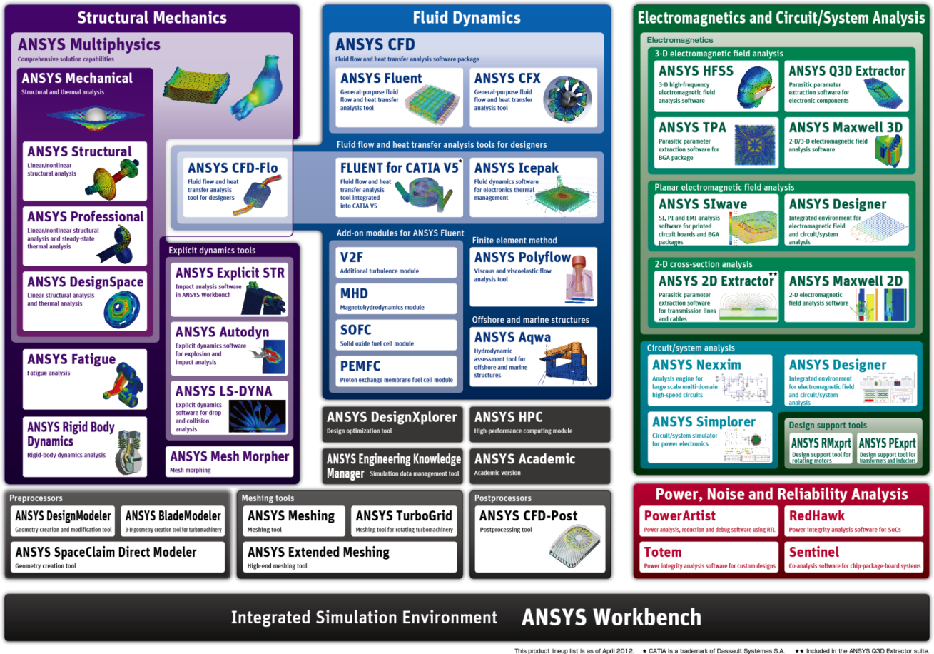
ANSYS产品家族

Slide 7
基于WorkBench框架的应用整合
电磁
Geometry Meshing Setup Solve Results
结构
Geometry
Meshing Setup Solve Results
CFX
Meshing
Setup
Solve
Results
Fluent
Setup Solve
应用集成
Scripting
Parameterization
Framework Toolkit
Data and Process Management
Component applications, covering various phases of the simulation process, sitting on top of a common framework

Slide 8
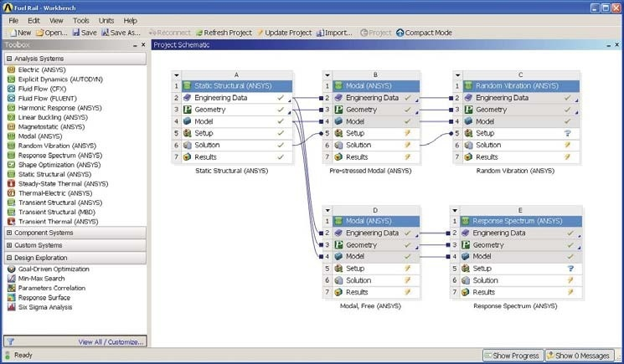
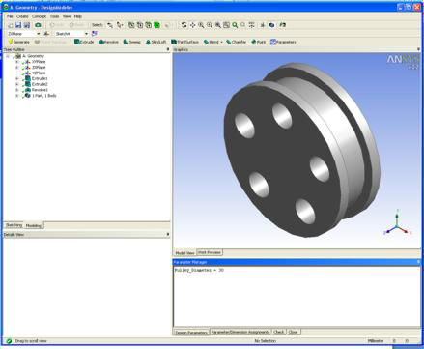
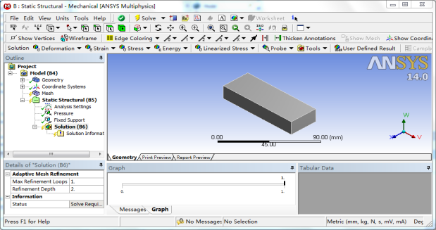
WorkBench的应用
Native applications
Built entirely on WB2 Framework
Embedded within the “Workbench” window
Project Schematic, Design Exploration, Engineering Data
Fully supported by Workbench scripting
Scripting Language: Python
Data-integrated applications
Share data and parameters with Workbench, native applications, and other data-integrated applications
Independent UI, window
E.g., Mechanical, Mechanical APDL, CFX, FLUENT, DM
Scripting Language: JScript, Scheme, APDL …

Slide 9
WorkBench的应用
Native applications
Built entirely on WB2 Framework
Embedded within the “Workbench” window
Project Schematic, Design Exploration, Engineering Data
Fully supported by Workbench scripting
Scripting Language: Python
Data Integrated Applications | Native Scripting Language
Mechanical APDL | APDL
Mechanical | Jscript
DesignModeler | Jscript
Meshing | Jscript
FE Molder | Jscript
AQWA | Jscript
ICEM CFD | TCL
CFX | CCL
CFD Post | CCL
FLUENT | Scheme
PolyFlow | N/A
IcePak | N/A
AUTODYN | N/A
？
Data-integrated applications
Share data and parameters with Workbench, native applications, and other data-integrated applications
Independent UI, window
E.g., Mechanical, Mechanical APDL, CFX, FLUENT, DM
Scripting Language: JScript, Scheme, APDL …

Slide 10
ANSYS客户定制开发工具/技术
Python Journaling
For task automation at WB level
Creating Project, Performing Parameters simulations etc.
Can use Jscript macros for DM, Meshing, Mechanical etc.
JScript (for DM, Meshing, Mechanical etc.)
Automation scripts
JScript add-in to add functionality
Wizards (for DM, Meshing, Mechanical etc.)
Creating a customized workflow
ACT (for Mechanical)
Creating custom objects in tree for advanced customization
External Connection Add-in
Making external applications (not integrated with WB) to participate in workflow through parameters
Python scripting can be integrated to add functionality to WB
C# Add-in using Software Development Kit (SDK)
Integrate external applications in workflow through custom systems
WB GUI customization (addition of buttons, menu etc.)
SDK offers much more access compared to External Connection

Slide 11
ANSYS客户定制开发工具/技术
客户化
SDK
组件化流程化
用户界面：
自定义开发 C#、VB、Java、…
ANSYS UIDL / ANSY TK
WB HTML
ACT
用户垂直应用
处理逻辑：
ANSYS APDL / ANSYS TCL
WB JavaScript / WB Python
CFX CCL
用户功能扩充：
ANSYS UPF、Fluent UDF
API
API
API
ANSYS内核

Slide 12
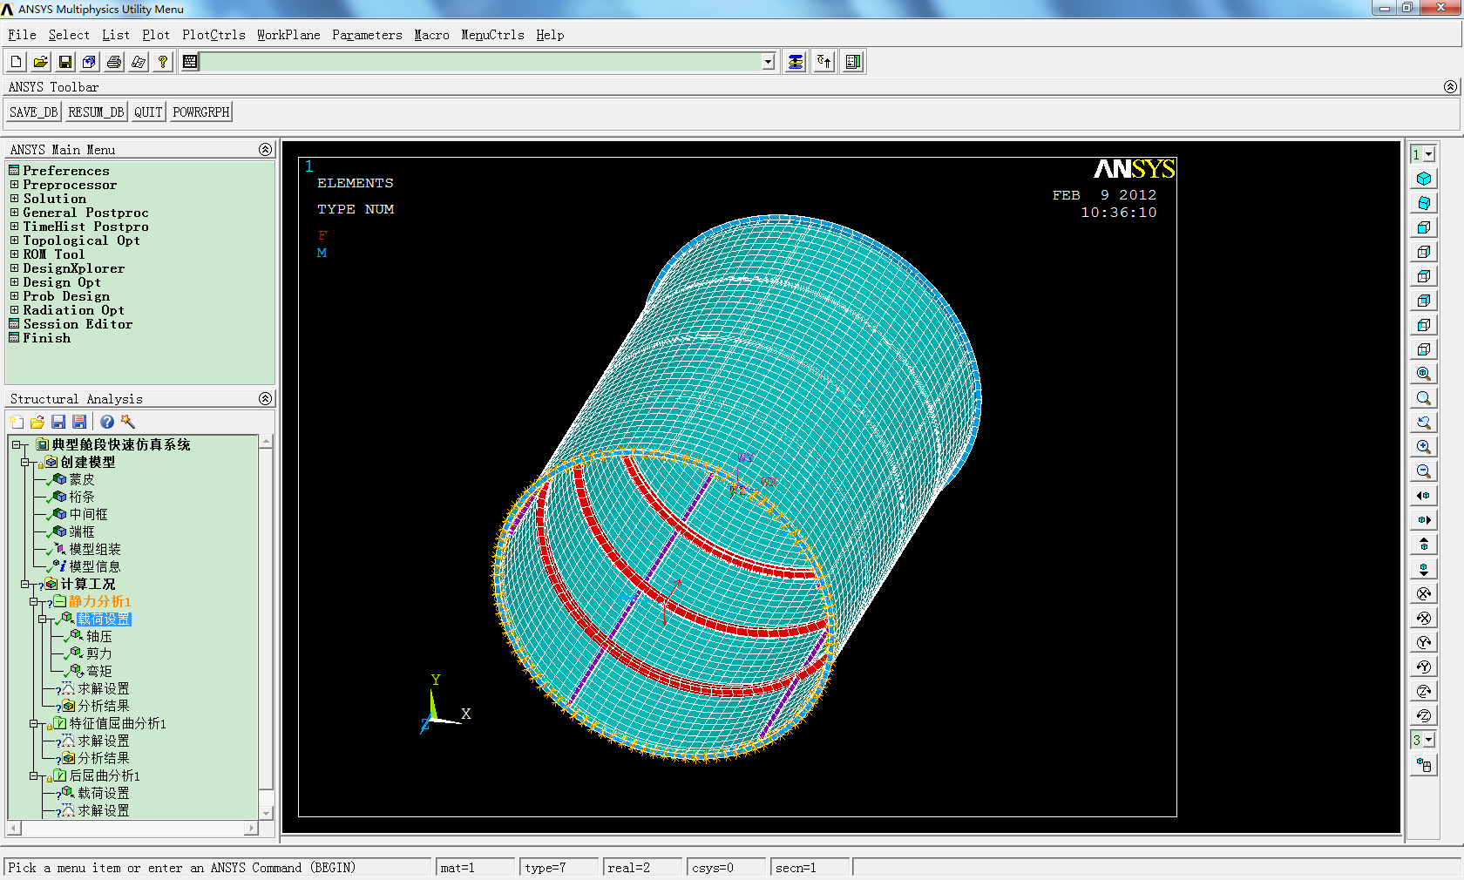
经典ANSYS定制开发：TCL/TK+APDL

Slide 13
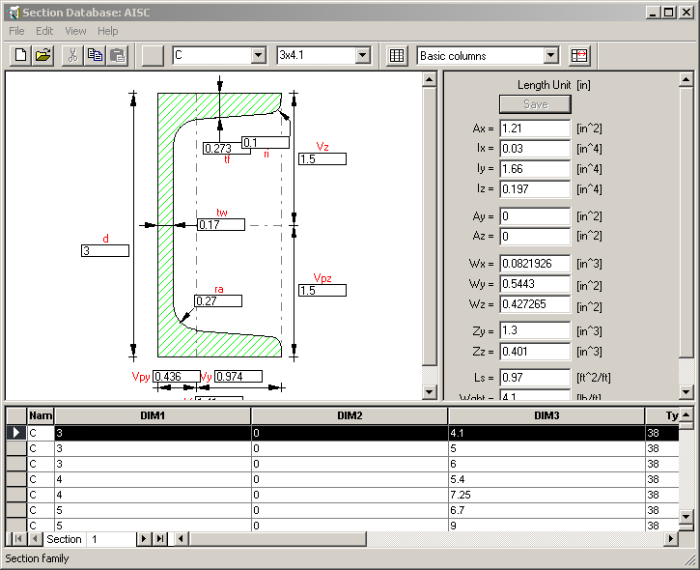
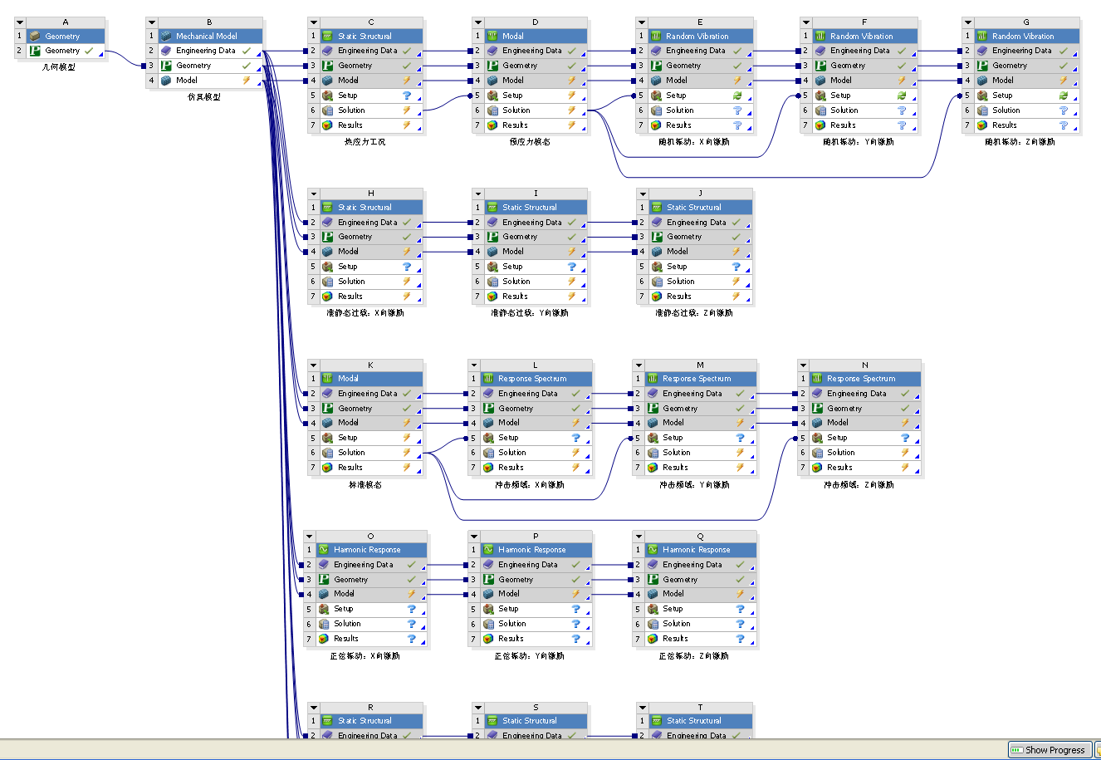
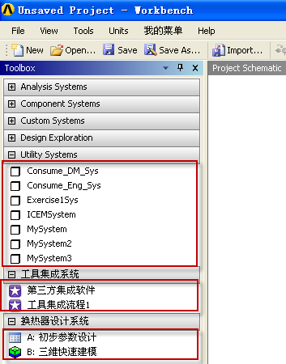
ANSYS WorkBench定制开发：SDK

Slide 14
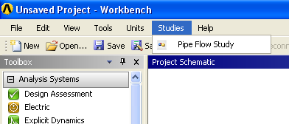
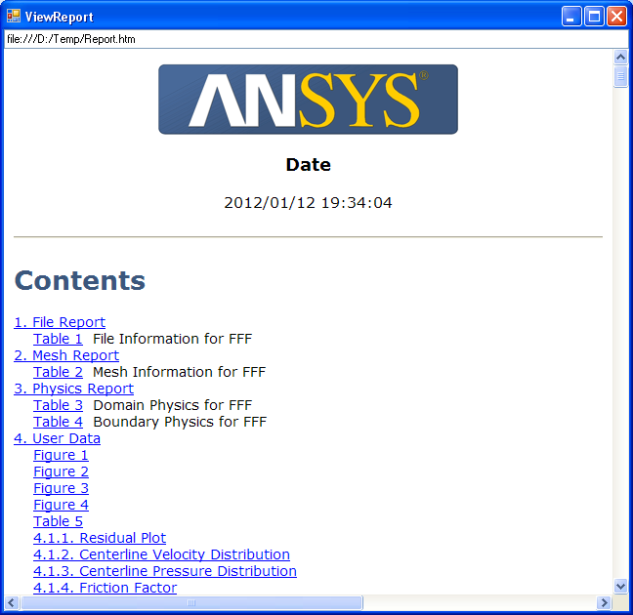
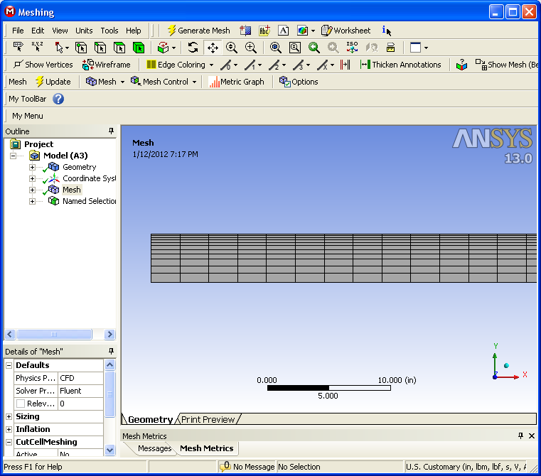
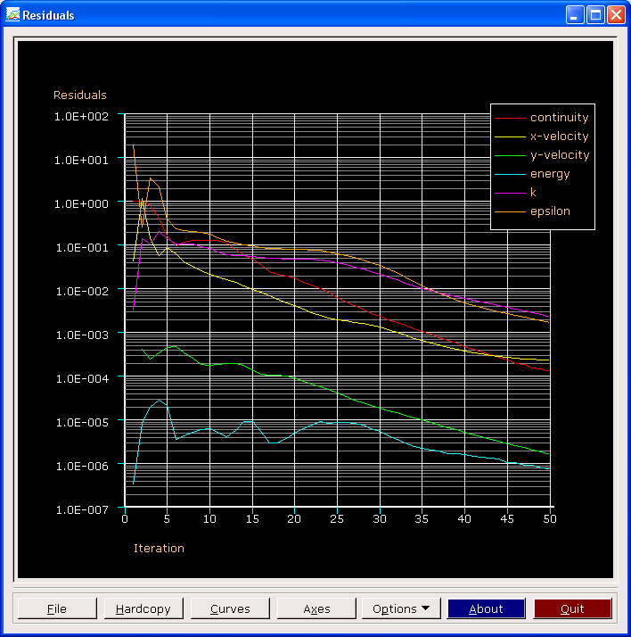
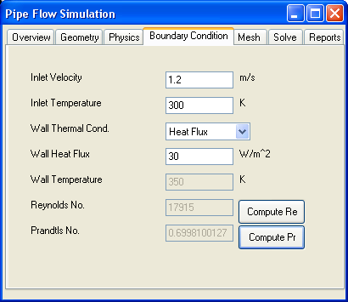
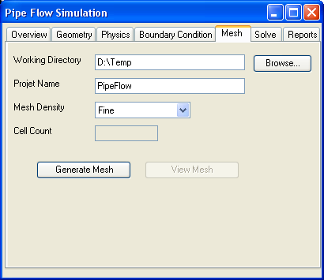
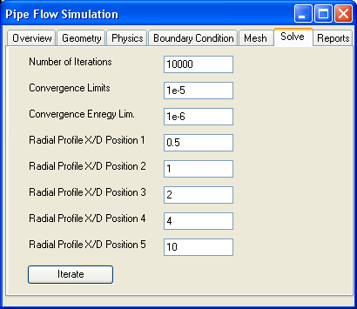
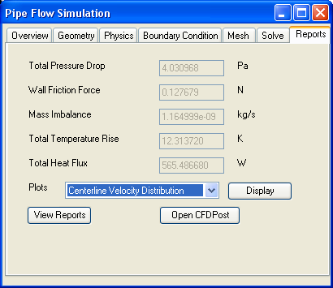
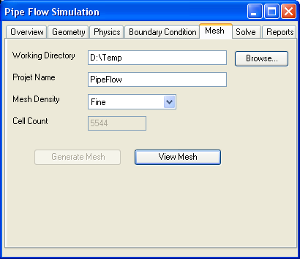
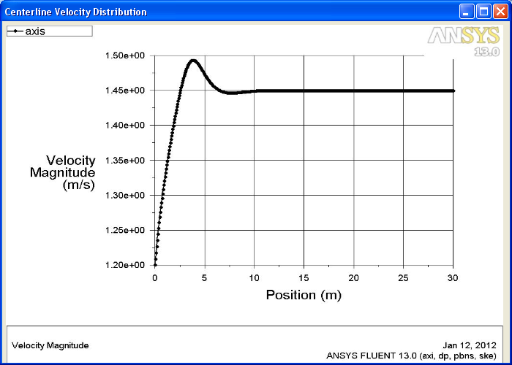
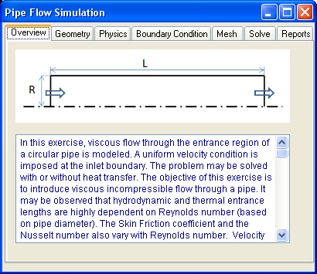
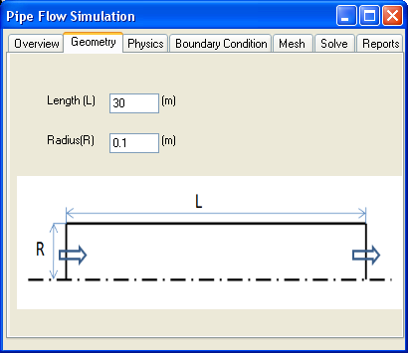
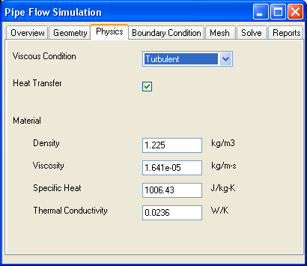
ANSYS Workbench GUI定义
A custom GUI opens that allows a Pipe Flow CFD Simulation
Provide the dimensions of the pipe
Provide the inputs
Some standard results are displayed for a quick check
Plots generated are available for display
The residuals are displayed as the simulation is progressing
Provide solver controls
A suitable mesh with appropriate Y+ is generated
View Mesh
Provide the inputs
Validate the flow condition
Provide some inputs for extracting results (radial profiles)
Iterate
Provide the inputs
Generate Mesh
Open CFD Post for an interactive post-processing
Open a standard report
(with plots, contours, vectors etc.)

Slide 15
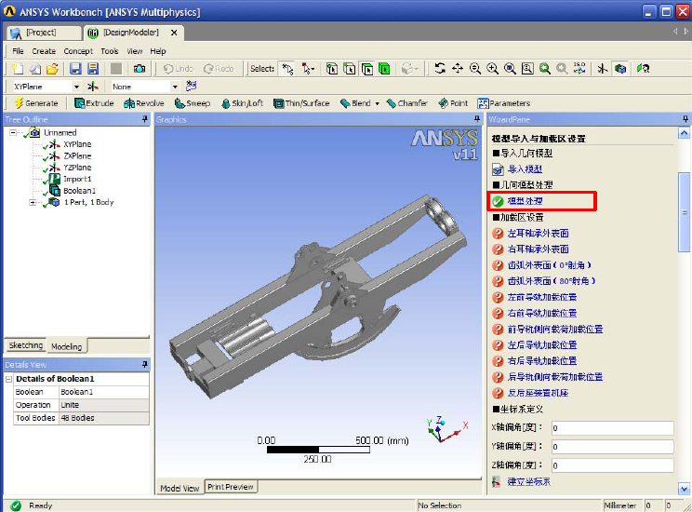
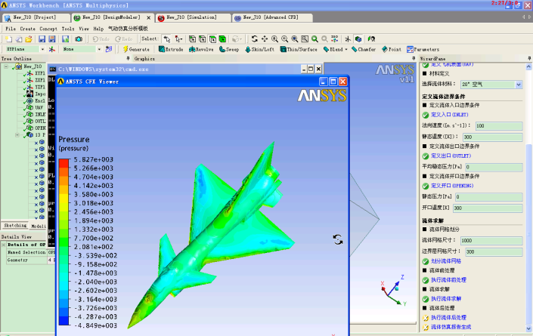
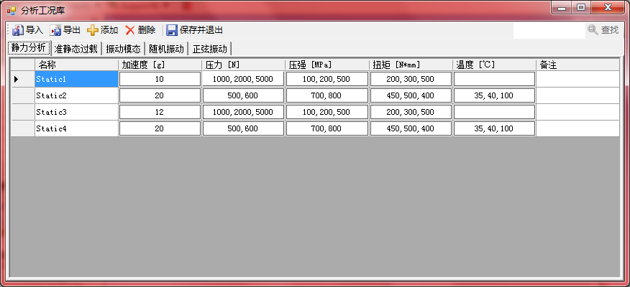
分析向导定义
Example:
A Customized Wizard in Mechanical to manage the workflow
Typical Usage:
Create a workflow in DM, Meshing, Mechanical etc.
Interface to take interactive inputs
Task automation
结构仿真模板
模型处理模板
流体仿真模板
载荷工况库

Slide 16
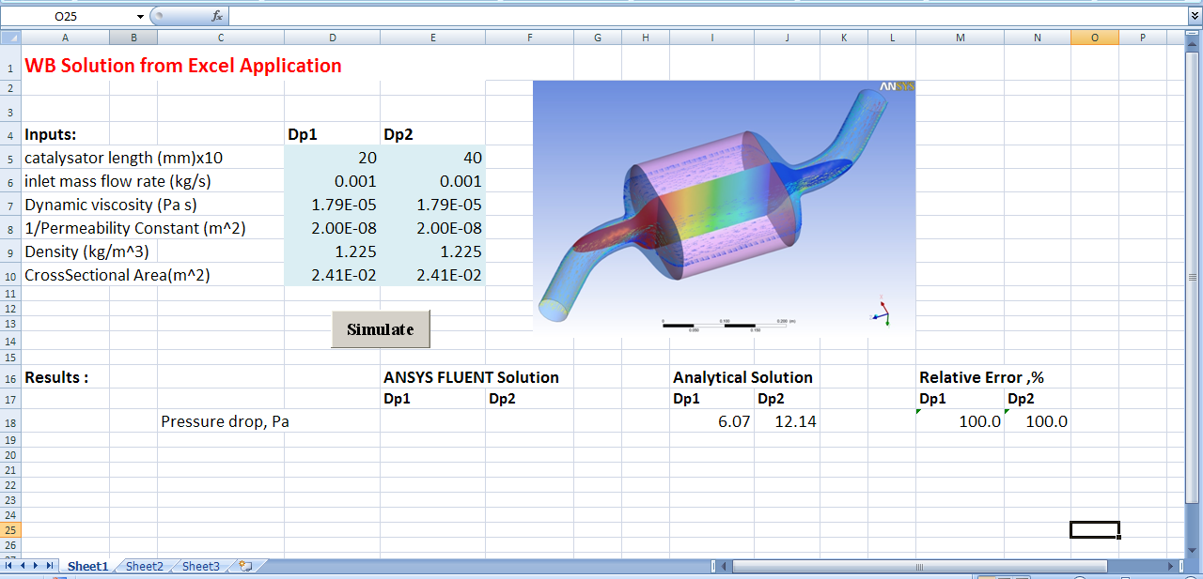
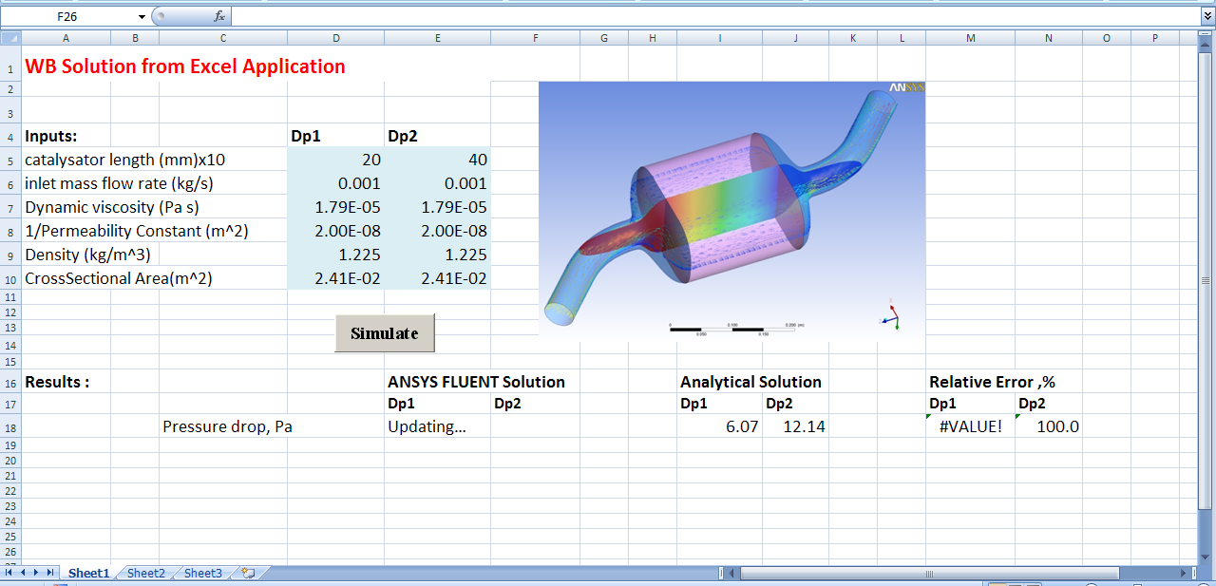
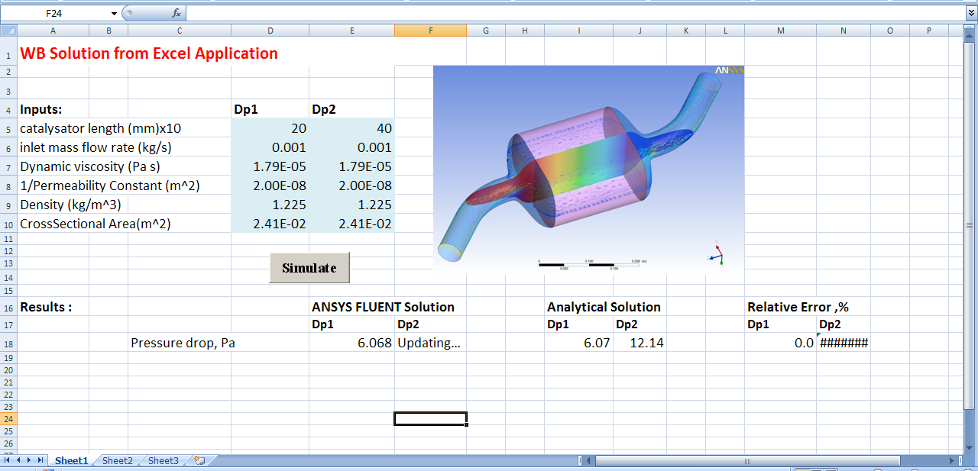

ANSYS定制开发：外部程序调用
Matlab
Excel
…
Provide the Parameters for the Design Point study
Both the DPs are solved, Project is saved.
Pressure drop values from those analysis are updated in Excel
WB simulation is started in the background.
DP1 simulation is Updating…
DP1 simulation is done.
DP2 Updating…

Slide 17
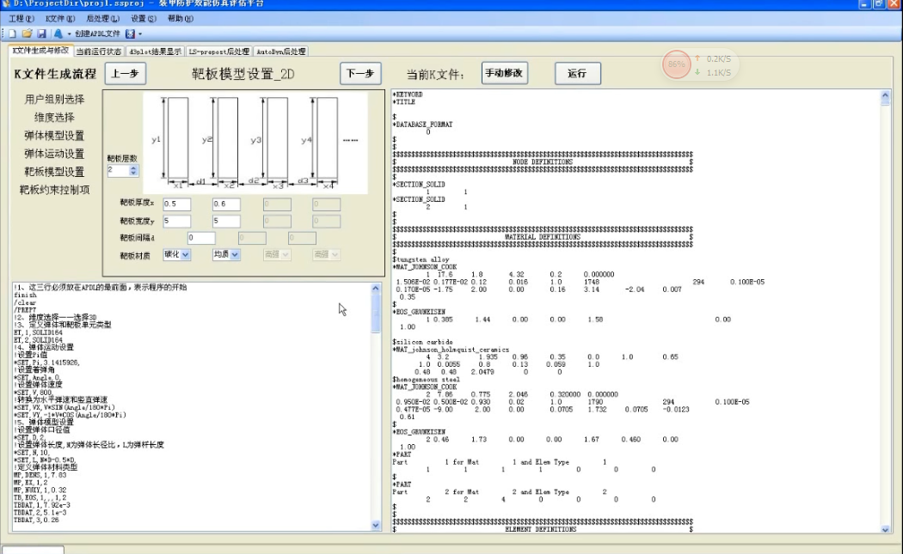
自定义专业系统，求解器后台调用
装甲防护效能仿真评估

Slide 18
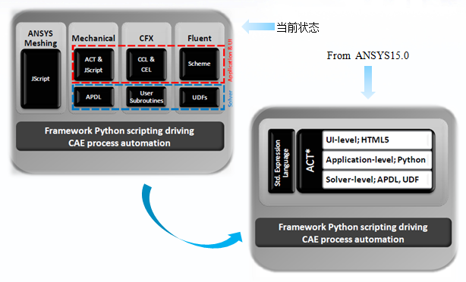
ACT（ Application Customization Toolkit ）技术

Slide 19
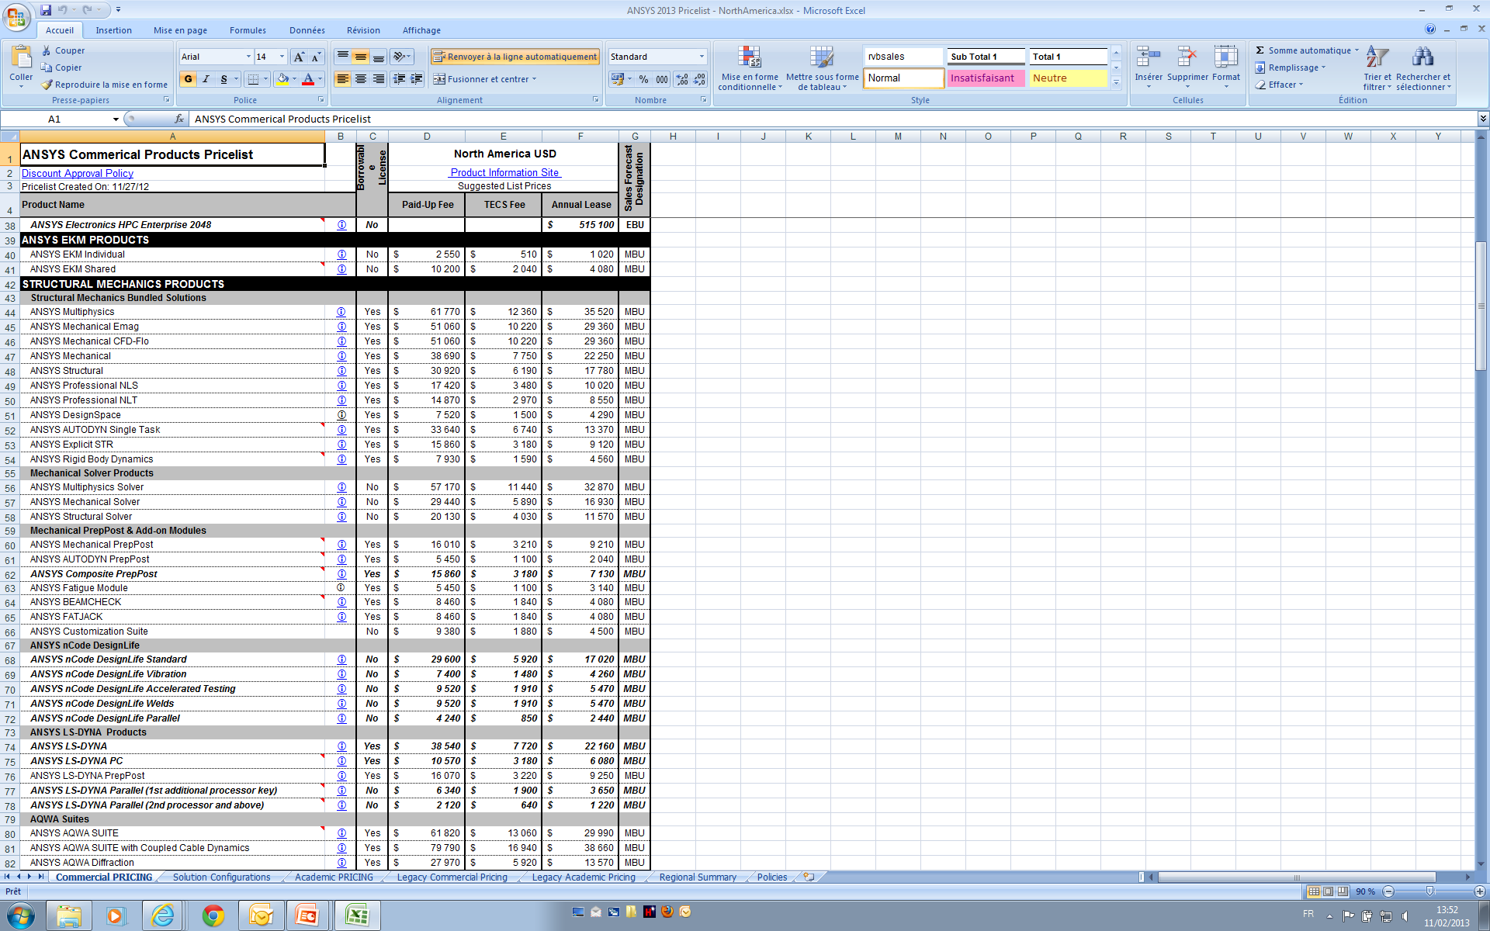
Customization strategy - ACT Plans
New at R14.5: “ANSYS Customization Suite”
Include ACT and the WB SDK
ACT Module officially released at R14.5
New item on the price sheet: “ANSYS Customization Suite”
FlexLM licensing introduced for the ACT Module
“ANSYS Customization Suite” license – “ans_act”*
WB SDK FlexLM licensing to be introduced at R15
Documentation, training material available
Set of extensions, python libraries provided as templates and aids
ACT is the long-term customization tool

Slide 20
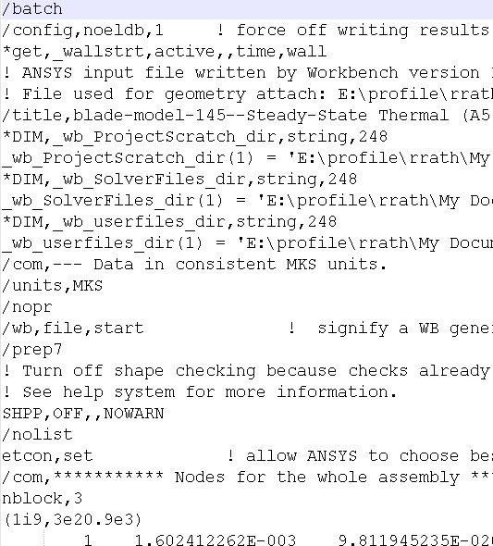
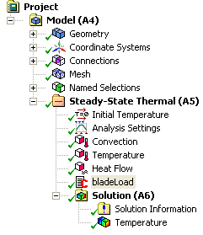
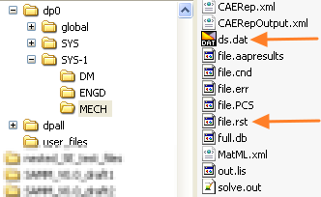
面向Mechanical的ACT主要开发方向
How standard Mechanical works:
When user “solves” an analysis in Mechanical , the following things happen
All items in the tree (Mesh, Contacts, Solver settings, Loads etc.) are converted to APDL commands → written as “ds.dat”
MAPDL is invoked in background, consumes this "ds.dat" and writes out the result to “file.rst”
Mechanical reads back the result (file.rst) and displays contours/vectors etc.
Where ACT comes into picture:
Mostly ACT comes into picture in step-1 and 3
ACT comes into picture in step-2 when one uses in-house/3rd party solver (instead of default MAPDL)

Slide 21
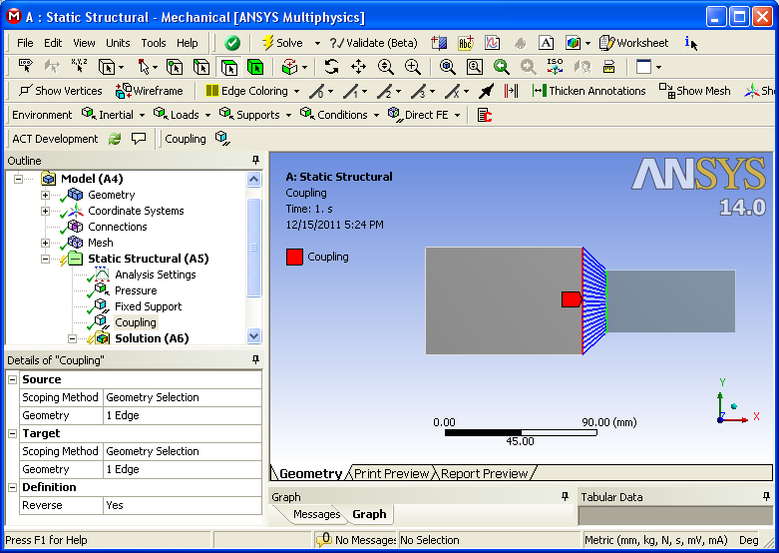
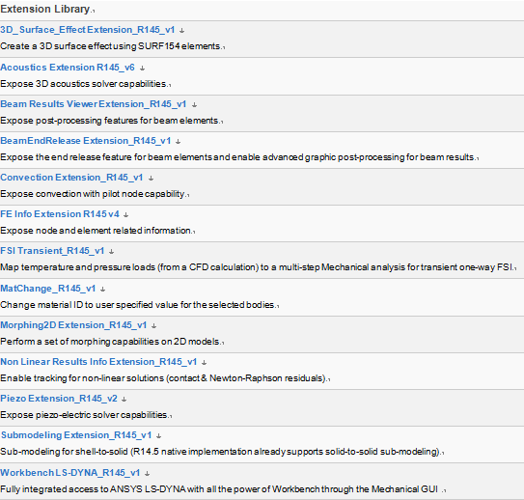
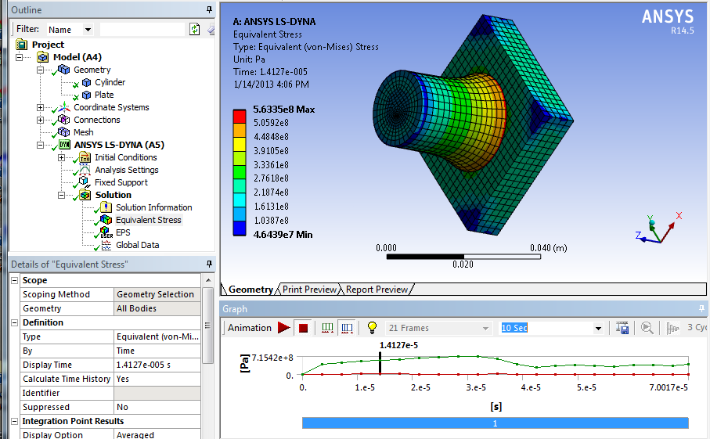
ACT 应用库
New extension for specific load creation
The Coupling object
Workbench LS-DYNA

Slide 22
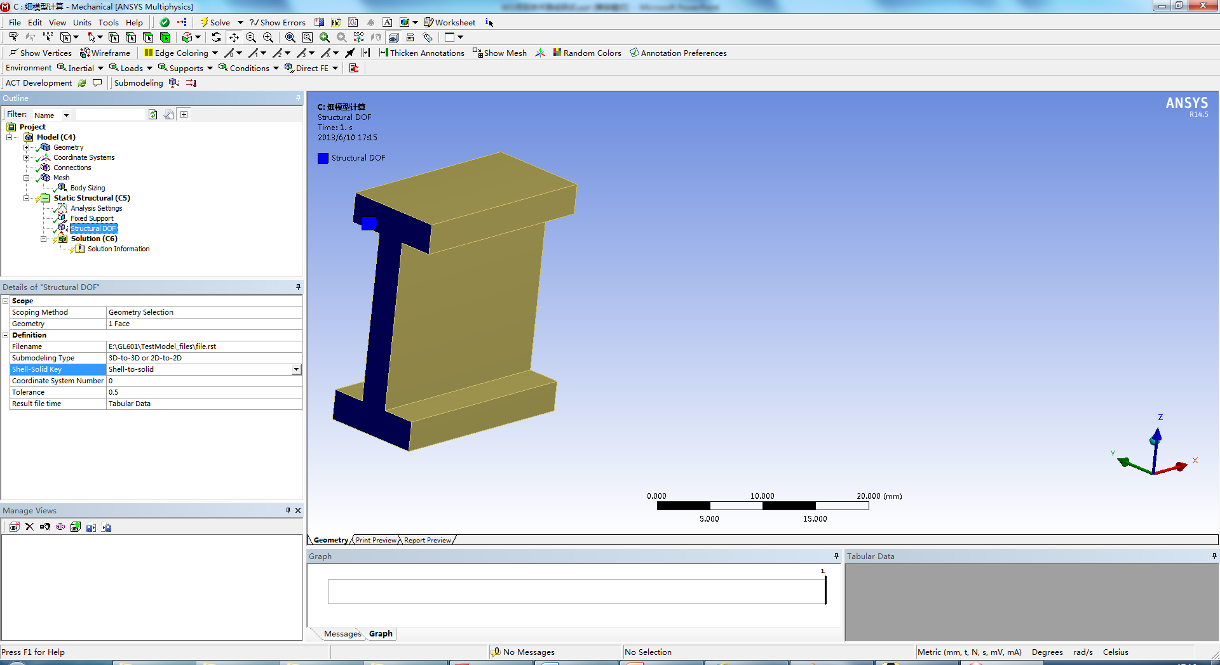
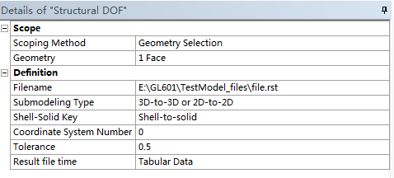
子模型计算技术路线测试：细模型计算（ACT）
细模型计算的核心是：粗模型向细模型进行边界自由度差值
基于ACT开发的SubModeling进行粗模型到细模型的边界差值
所需的输入：
细模型的差值边界
粗模型的rst文件

Slide 23
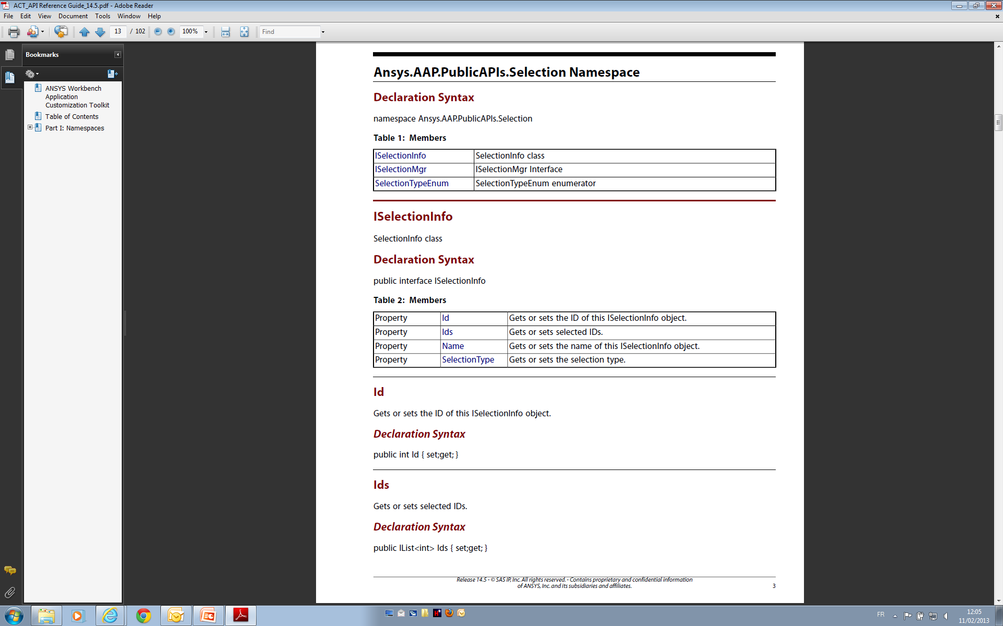
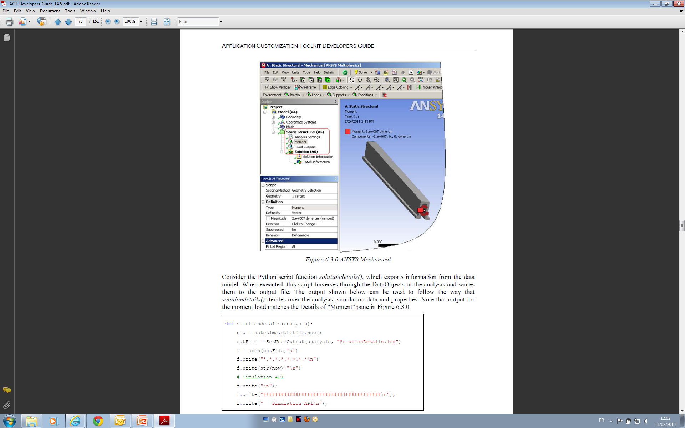
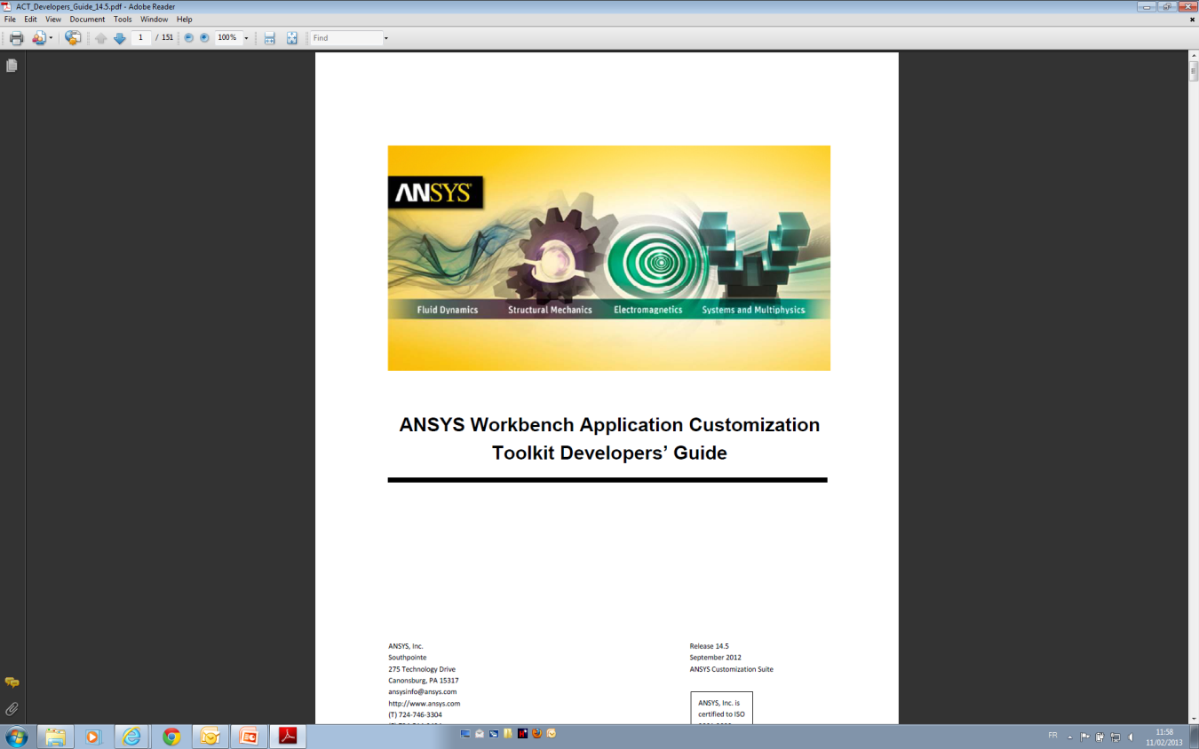
ANSYS 定制开发技术文档

Slide 24
面向工程的客户化定制开发应用

Slide 25
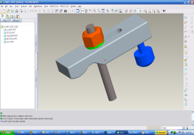
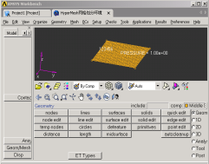

ANSYS 客户化定制开发应用
仿真任务：单学科、多学科、优化计算、疲劳计算、…
CAD
Preprocessing
Solving
Postprocessing
模型预处理
单学科求解
几何
分网
多学科求解
材料
后处理
边界条件
求解设置
优化
CAD工具
前处理工具
求解器
后处理工具
Catia
Pro/E
UG
DM
…
ANSYS
ICEM CFD
Patran
Hypermesh
…
结构
流体
电磁
耦合
优化
ANSYS
ANSYS
ICEM CFD
Patran
Hypermesh
…
CFX
Fluent
ABAQUS
DX
Nastran
Feko
FE-Safe
模型库
截面库
…
分网规则
材料库
计算
工况
载荷库
…
数据存储
…
报告模板
评价
规范
…

Slide 26

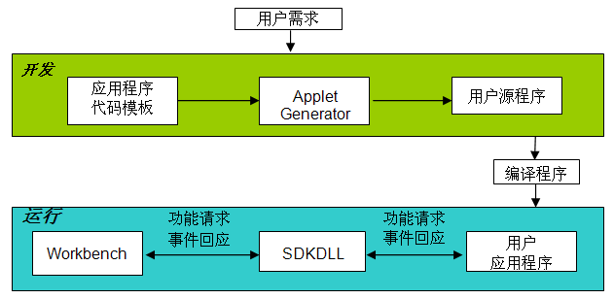
ANSYS 客户化定制开发应用
仿真任务：单学科、多学科、优化计算、疲劳计算、…
专业化应用-工程化
面向工程应用的专业系统
分析流程-模板化
CAD
Preprocessing
Solving
Postprocessing
模型预处理
单学科求解
几何
分网
多学科求解
材料
后处理
边界条件
求解设置
优化
CAD工具
工具集成：软件集成，统一界面
前处理工具
求解器
后处理工具
Catia
Pro/E
UG
DM
…
ANSYS
ICEM CFD
Patran
Hypermesh
…
结构
流体
电磁
耦合
优化
ANSYS
ANSYS
ICEM CFD
Patran
Hypermesh
…
CFX
Fluent
ABAQUS
DX
Nastran
Feko
FE-Safe
仿真分析资源库（模型库、材料库、截面库、载荷库、…）：统一管理，提高效率
模型库
截面库
…
分网规则
材料库
计算
工况
载荷库
…
数据存储
…
报告模板
评价
规范
…

Slide 27
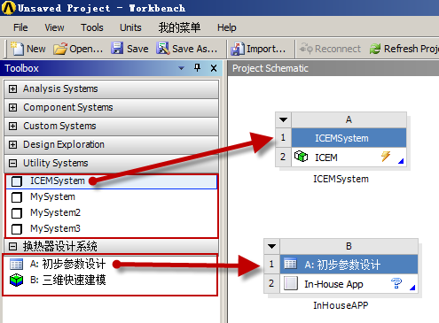
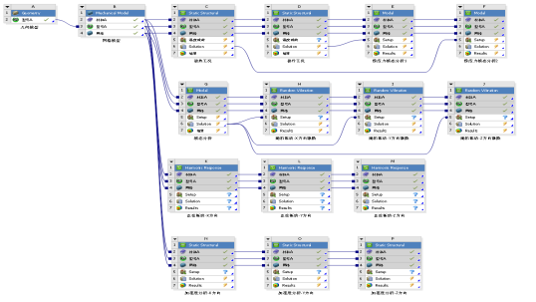
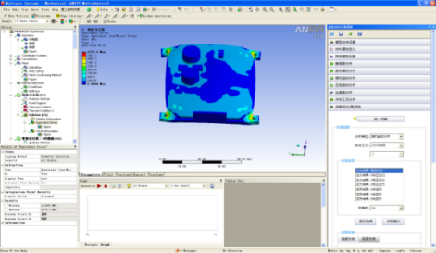
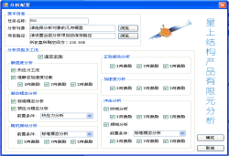



ANSYS 客户化定制开发应用
多学科工具集成
仿真流程定制
仿真计算环境
ANSYS客户化定制
自研算法封装
资源库集成

Slide 28









ANSYS 客户化定制开发综合应用案例
基于配置的分析流程自动建立
工程资源库：模型库、网格规则库、载荷工况库、多方案结果库
基于工程资源库进行建模、分网及边界条件定义
自定义应用界面，求解器完全封装在后台
多方案数据结果的曲线比对及报告输出

Slide 29






ANSYS 客户化定制开发综合应用案例
自研程序、第三方程序的集成
复杂的数据传递关系
基于规范和经验封装的向导式模板开发
基于tecplot的统一数据后处理
报告的自动生成

Slide 30







ANSYS 客户化定制开发综合应用案例
经典ANSYS环境
工况及边界提交统一设置，一次性提交计算
计算结果根据路径自动提取
基于提取的数据进行进一步的损伤评估
ASME规范的集成

Slide 31


总结
通用软件+定制开发技术+ 专业(流程/经验/知识/规范/…) = 面向特定应用的专业化系统
- 固化仿真流程
基于模板的仿真应用
经验知识的封装与重用
仿真流程的自动创建
过程数据的自动关联
求解设置向计算文件的自动转换
结果自动提取
- 分析报告自动生成
仿真过程得到了规范化
仿真效率得到了大大提高
专业化系统
解放人力促进智力创新
对比分析提高设计质量
- 避免重复劳动、解放人力
- 关注关键问题、智力创新
- 多方案多工况结果及对比分析
- 优中选优，促进设计质量

Slide 32
EKM实施项目

Slide 33




EKM实施项目
仿真任务启动
数据审批
终止仿真任务

Slide 34
Thanks

